Slide 1
Applied ML Tips
CS3300 Data Science

Slide 2
Go To ML Models
Classification
Regression
Logistic Regression
SVMs
Random Forests
Linear Regression
SVMs
Random Forests

Slide 3
Go To ML Models
Classification
Regression
Logistic Regression
SVMs
Random Forests
Linear Regression
SVMs
Random Forests
Noticing any patterns?

Slide 4
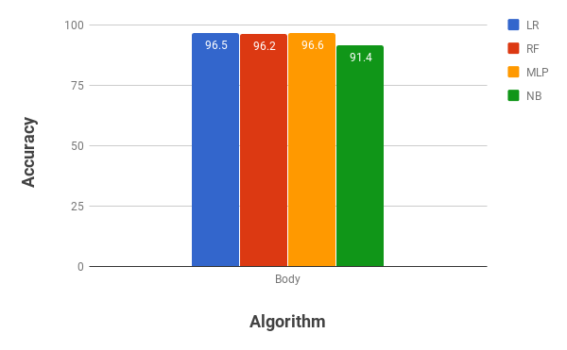
How do we choose which model to use?
Logistic Regression
SVMs
Random Forests

Slide 5
Random Forests
Assuming that:
You have 100's of features, not tens of thousands
You have 10,000's of samples, not millions
You are not worried about overfitting
Use a Random Forest
Often the best overall classification accuracy
Interpretable
Does not require a lot of tuning (just use >= 100 trees)

Slide 6
When Not to Use a Random Forest

Slide 7
When Do I Use Deep Learning?
Image Data
Convolutional neural networks
Sequence or text data
Recurrent neural networks
Long Short-Term Memory (LSTM) networks

Slide 8
When You Need Probabilities
In most cases, we simply need a categorical output (true / false, residence type, etc.)
But in some cases, we want probabilities: p(y = 1 | x) = probability that sample x belongs to class 1

Slide 9
Example: Ad Bidding
For example, in digital advertising, we need to bid in an auction to show a user an ad
We a model like so: bidPrice = expectedValueOfClick * p(click | x)
We needed accurate estimates of the probabilities

Slide 10
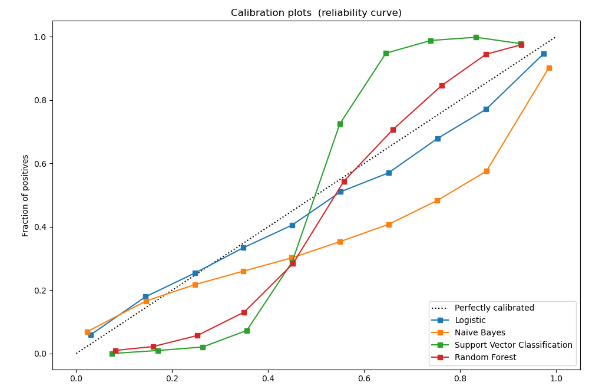
Probability Estimates
Logistic Regression:
Accurate probability estimates
Random Forests:
estimate probabilities from training entries at leaf
Not very accurate
SVMs:
Uses a computationally expensive cross-fold validation approach to estimate probabilities
Not very accurate
Naïve Bayes:
Although it can estimate probabilities, it's not very accurate

Slide 11
Web Scale
Companies with many users such as Facebook and Twitter are some of the biggest adopters of machine learning
These platforms have millions of users and may have billions of records in their data sets
Computational complexity of training algorithms matters at large scale
Longer run times -> higher costs

Slide 12
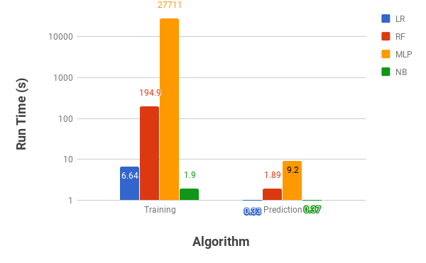
Training Time
Logistic Regression (with SGD): O(n p e) for e epochs
Random Forests: O(n² log(n) p)
SVMs: O(n² p) to O(n³ p)
Training logistic regression models is much faster than training Random Forest or SVM models

Slide 13
High Dimensional Data
Some problems (e.g., those involving text data) involve feature matrices with hundreds of thousands to millions of features
The number of features used by a decision tree or Random Forest is limited to the height of tree
Can lead to poor performance on the testing set or real data
Linear models can use more of the features
Leads to better performance on the testing set and real data

Slide 14
High Dimensional Data
Sparsity in high dimensional data sets can help with training and prediction times
In linear models like SVMs and Logistic Regression
linear algebra operations are only calculated for non-zero entries
reducing run time
Random Forests are not optimized for sparse data

Slide 15
Improve Models

Slide 16
How Do We Improve Model Accuracy?
First of all, how accurate is an "accurate" model?
For many applications, a "good model" will have 85-95% accuracy
It depends on your application
E.g., in online advertising, errors in probabilities lead to:
Bidding and therefore spending more than you need to win the auction
Under-estimating bids and losing opportunities to show ads
It's important to understand how the model predictions will be use and how they relate to business processes

Slide 17
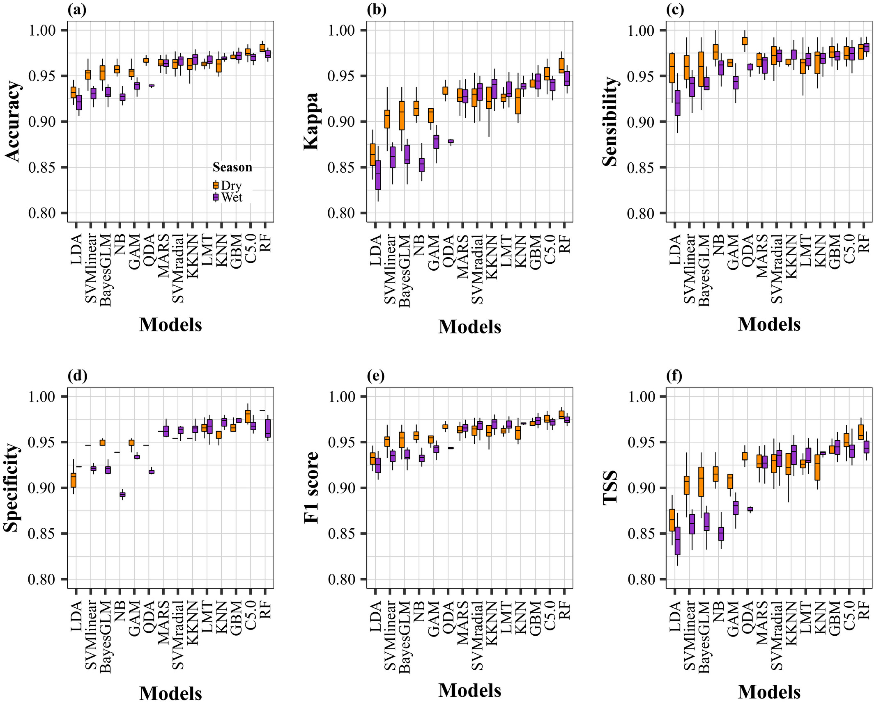
How Do We Improve Model Accuracy?
Try different models
Collect more records
Identify new types of data to collect

Slide 18
From xlvwscs@net.il Wed Apr 11 21:18:50 2007
Return-Path: xlvwscs@net.il
Received: from DSL217-132-183-148.bb.netvision.net.il (89-139-22-235.bb.netvision.net.il [89.139.22.235])
by speedy.uwaterloo.ca (8.12.8/8.12.5) with ESMTP id l3C1Im0I024199
for <gnitpick@speedy.uwaterloo.ca>; Wed, 11 Apr 2007 21:18:49 -0400
From: "repairs" xlvwscs@net.il
To: gnitpick@speedy.uwaterloo.ca
Subject: Secure Web-Form
Date: Thu, 12 Apr 2007 04:18:33 -0300
MIME-Version: 1.0
Content-Type: multipart/related;
boundary="----=_NextPart_000_0004_01C77CB9.A20DDD00"
X-Mailer: Microsoft Office Outlook, Build 11.0.5510
Thread-Index: Acd8uaINCus5OCPWRZ2d2pVdMAveNQ==
X-MimeOLE: Produced By Microsoft MimeOLE V6.00.2900.2869
Message-Id: <FC6B2A13C68B036.F7152FB58C@net.il>

Slide 19
From: "repairs" xlvwscs@net.il
X-Mailer: Microsoft Office Outlook, Build 11.0.5510

Slide 20
Domains
net.il => { net.il, il }
amazon.co.uk => { amazon.co.uk, co.uk, uk }
User Agents
Microsoft Office Outlook, Build 11.0.5510 =>
{ microsoft, office, outlook, build, 11, 0, 5510 }
Thunderbird 1.5 (Windows/20051201) =>
{ thunderbird, 1, 5, windows, 20051201 }

Slide 21
